Slide 1
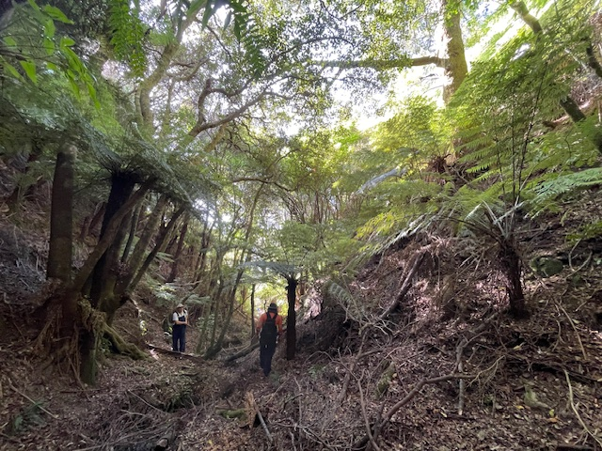
Plan Change 49 V1 Silverstream Spur
Don Skerman
3 April 2024

Slide 2
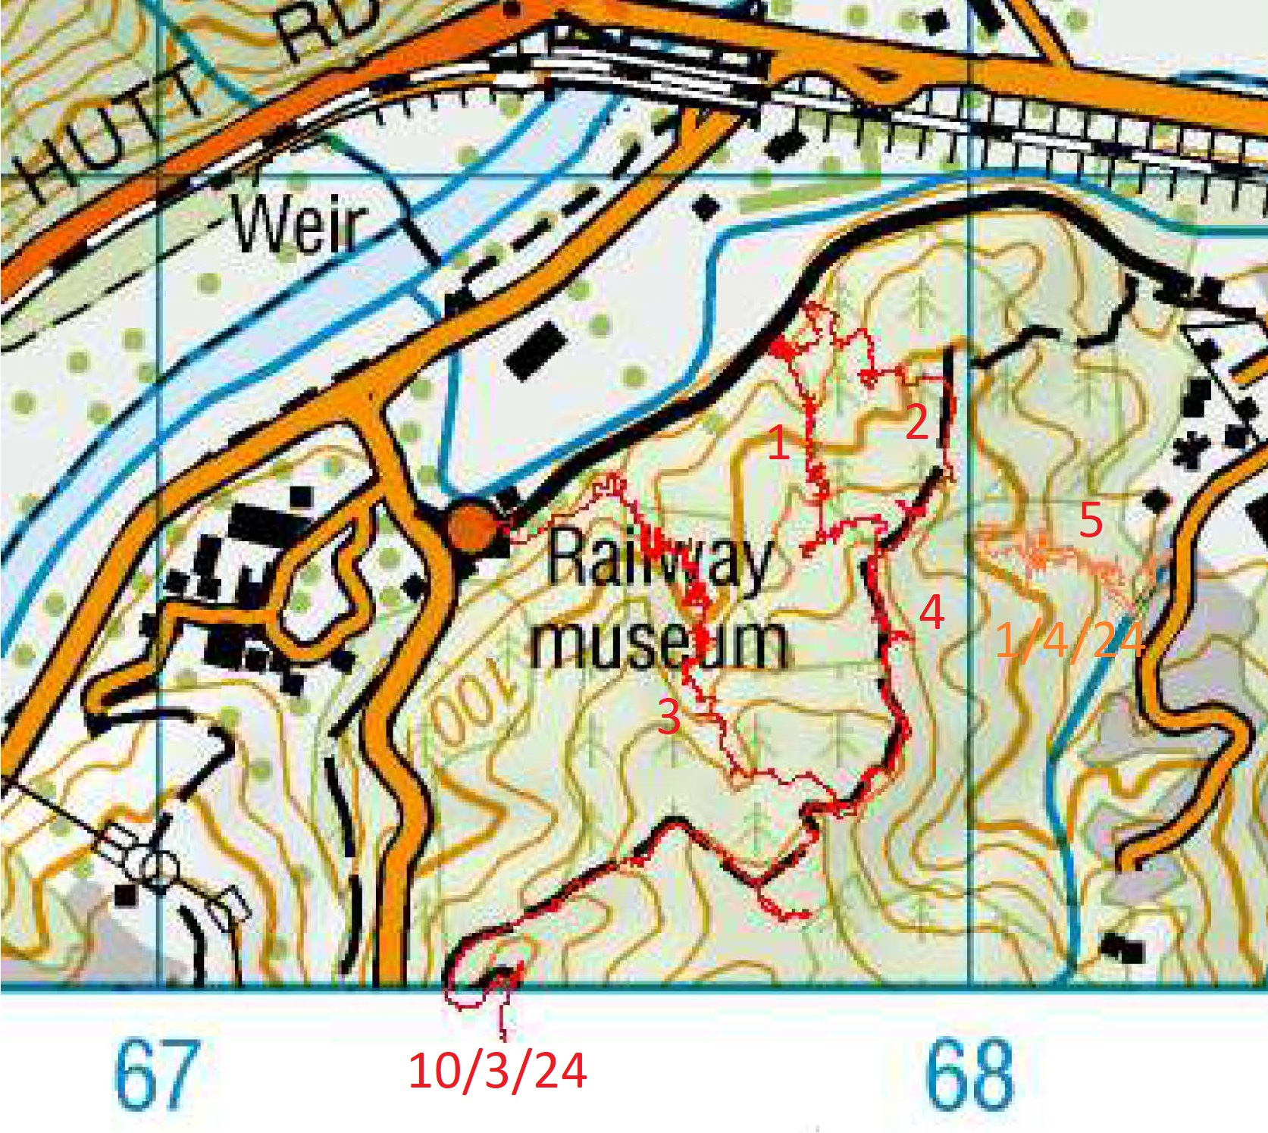
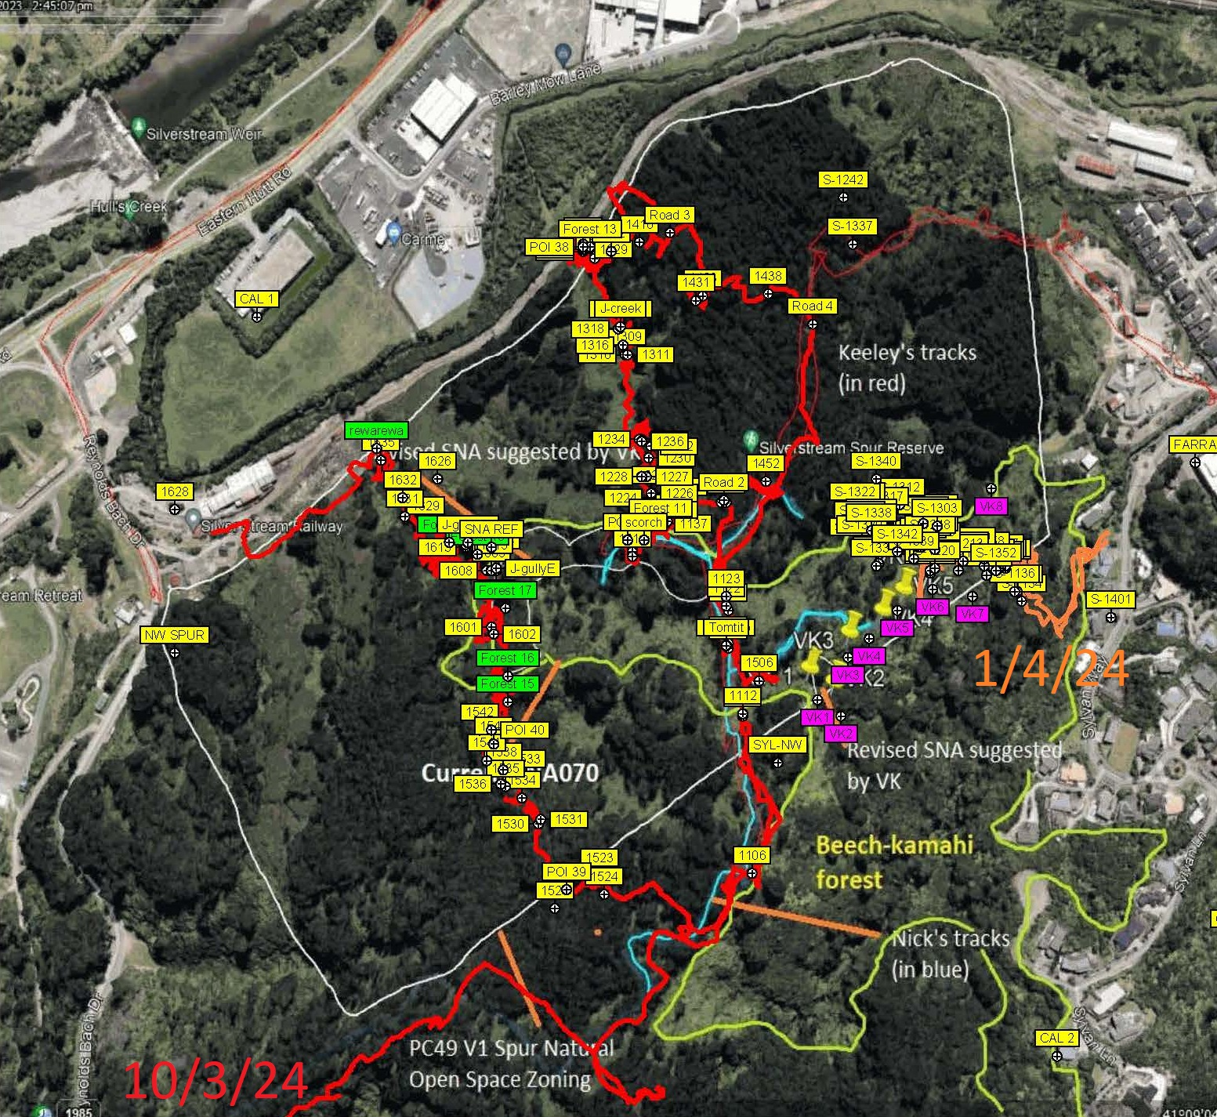
Route of site visit 10 Mar 24
Paraparaumu 1:50,000 topographic map
Attachment B Fig 1 from Mr Goldwater’s report

Slide 3
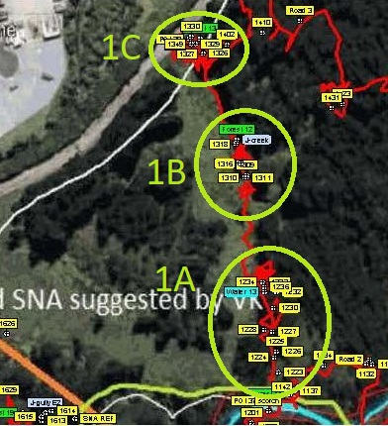
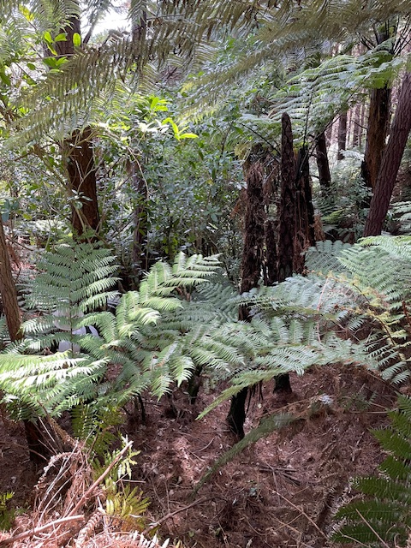
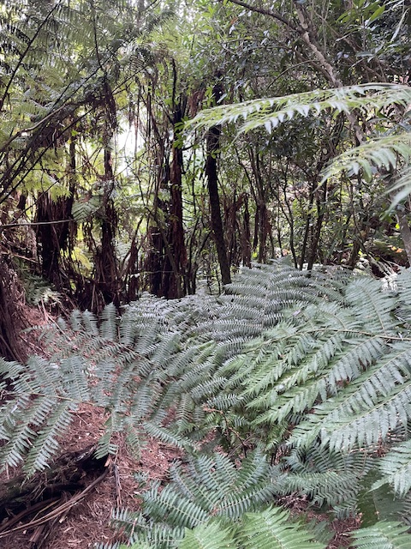
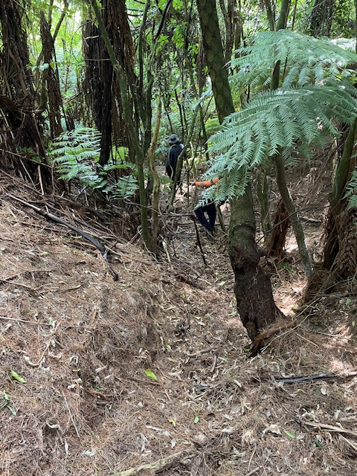
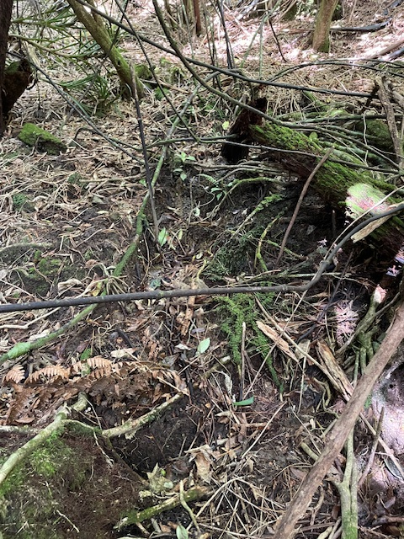
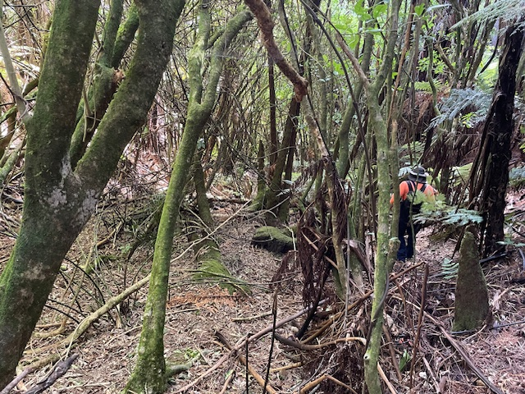
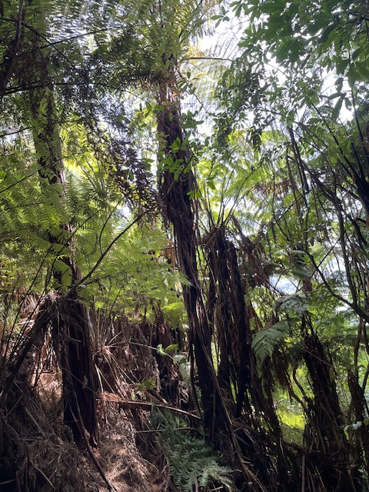
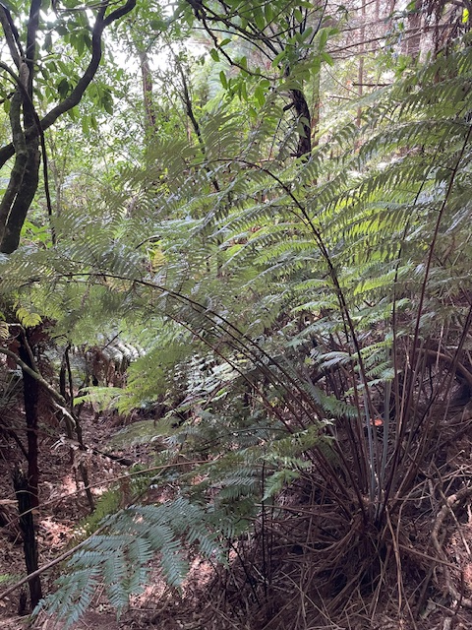
Section 1A gully photos (outside current SNA)
First water
mature ponga and mamaku, kareao, native tree seedlings to 5m
water flowing despite end of dry summer

Slide 4
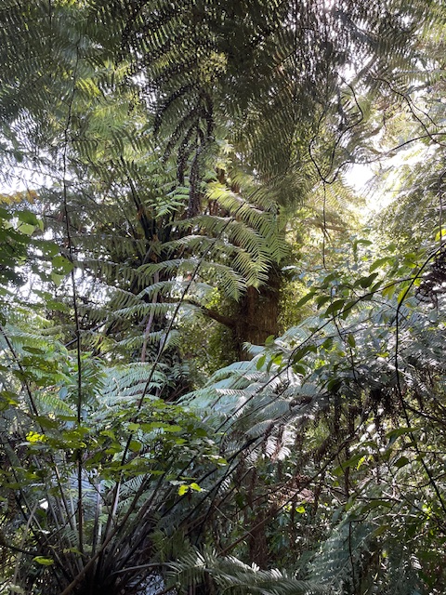
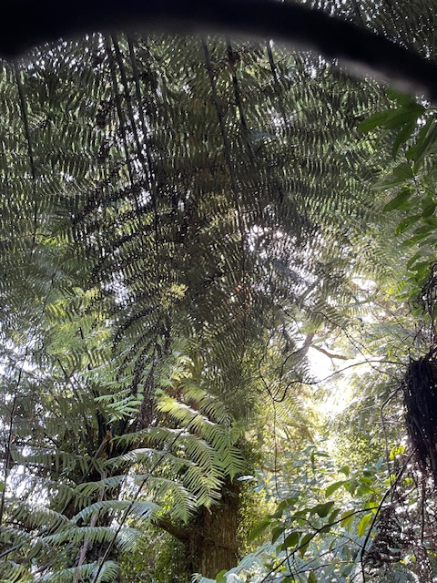
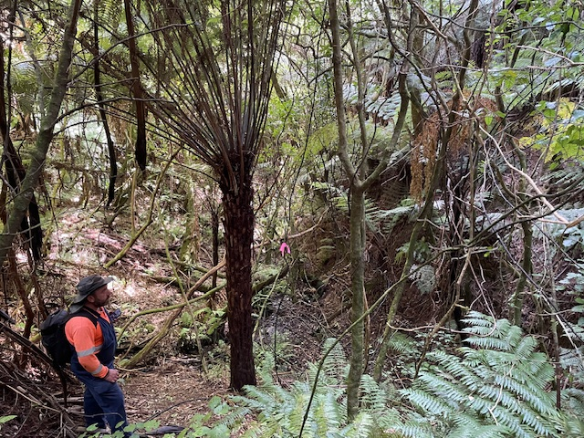
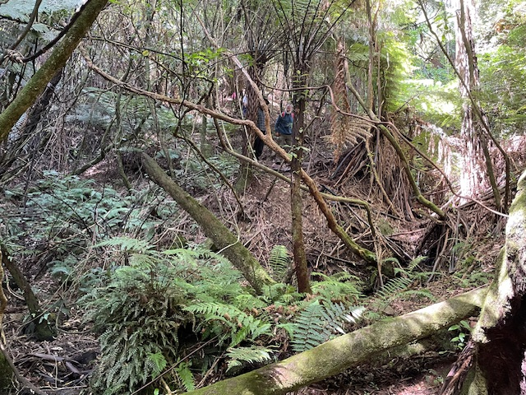
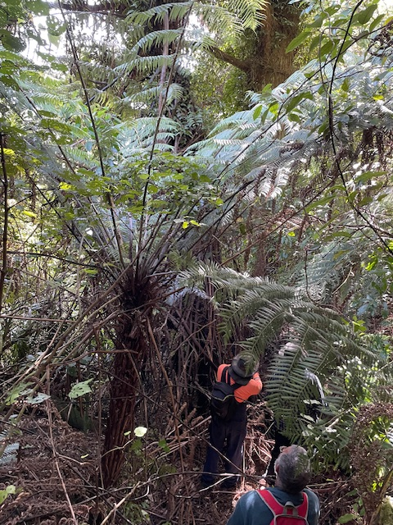
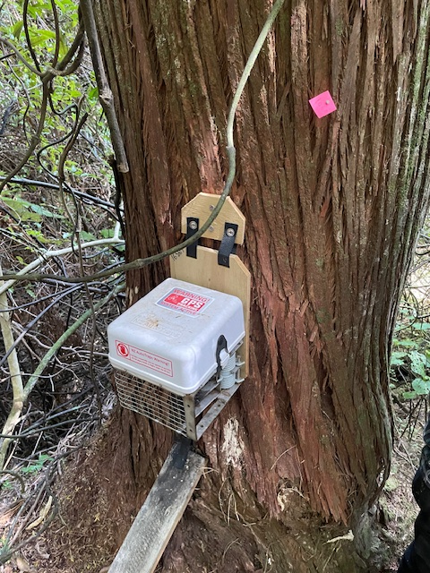
Section 1B gully photos (outside current SNA)
mature ponga and mamaku, kareao, tall tōtara and beech, native tree seedlings to 5m

Slide 5
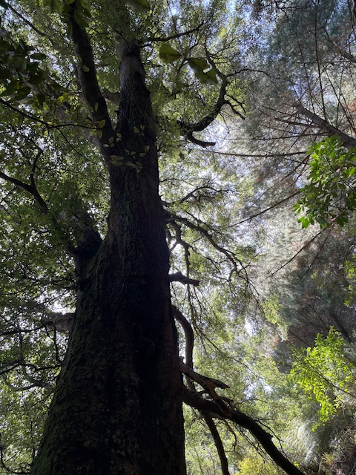
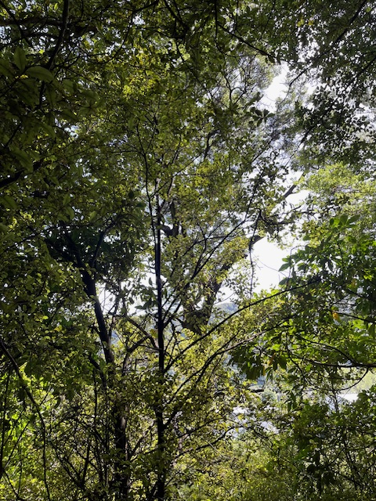
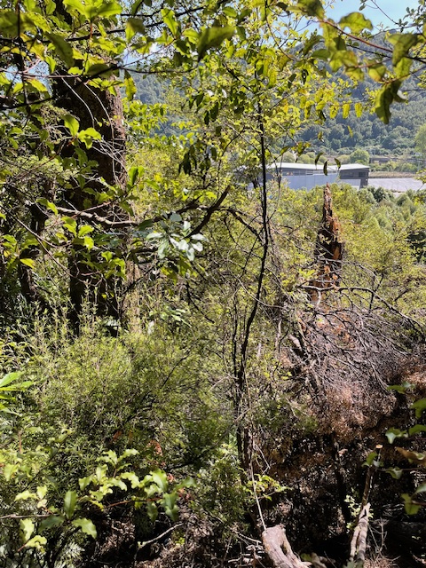
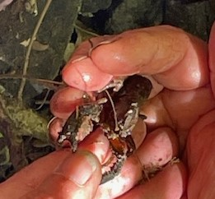
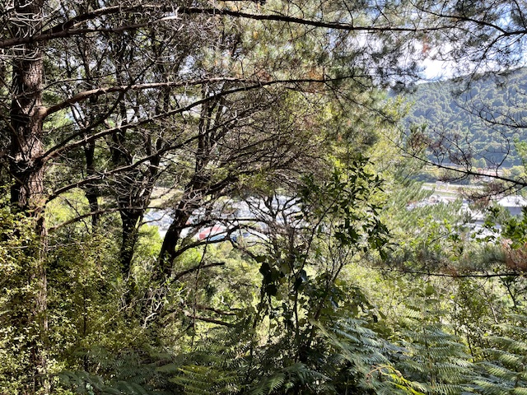
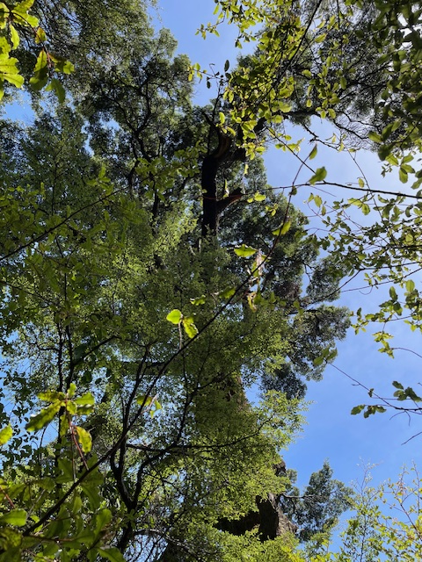
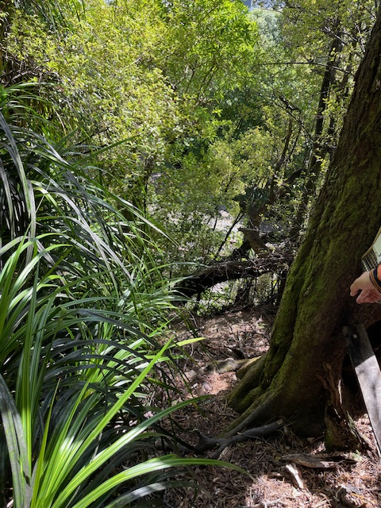
Section 1C gully photos (outside current SNA)

Slide 6
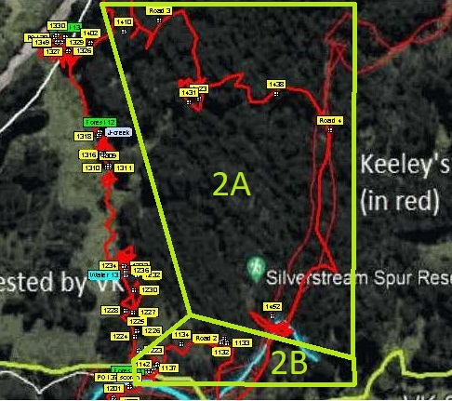
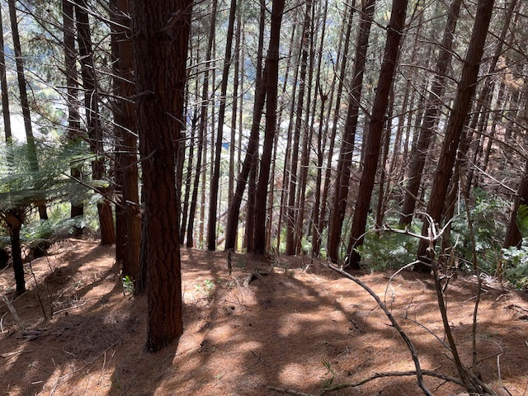
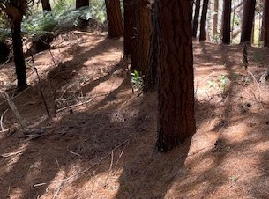
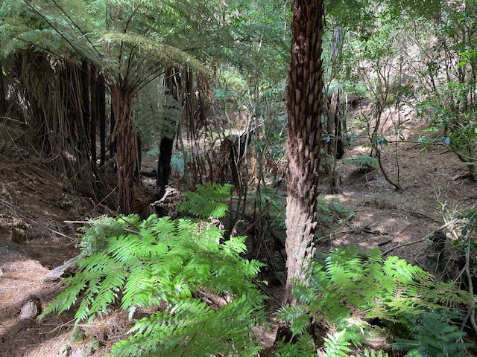
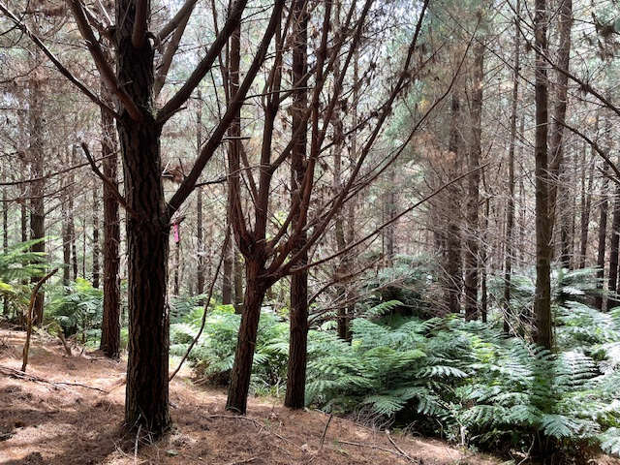
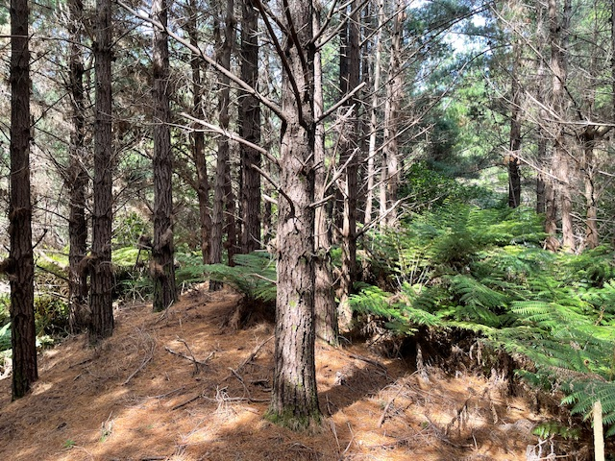
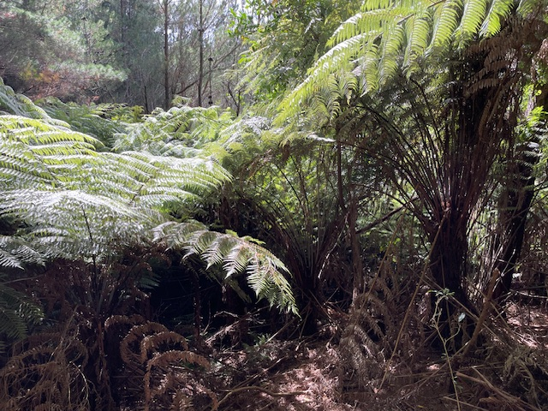
Section 2A (outside SNA)
ponga, native tree seedlings under plantation pines

Slide 7
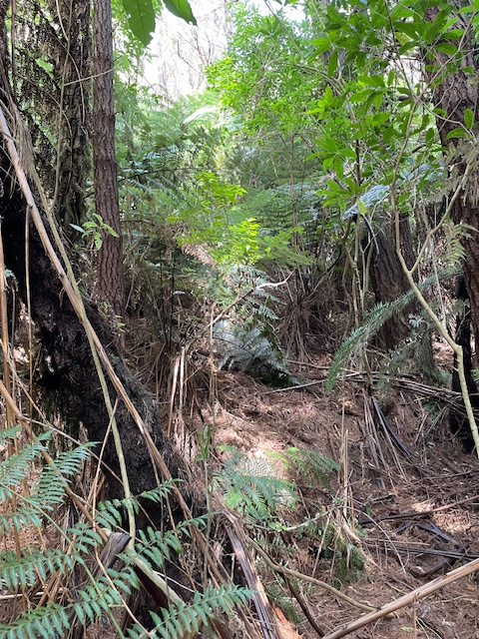
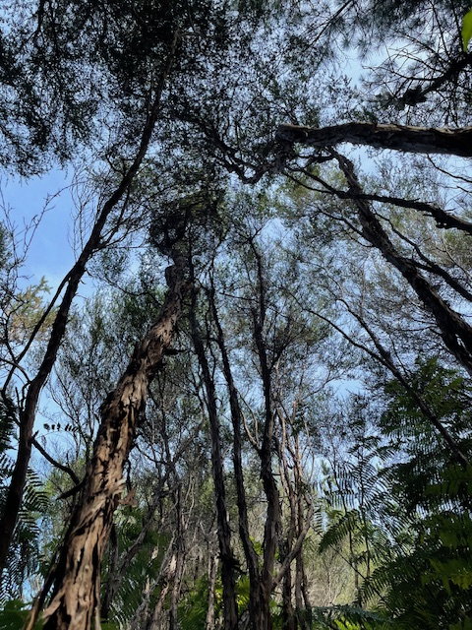
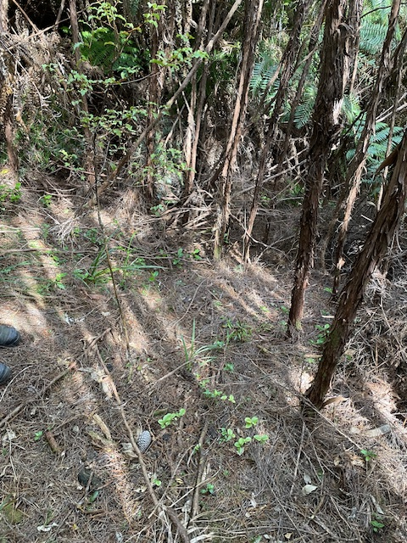
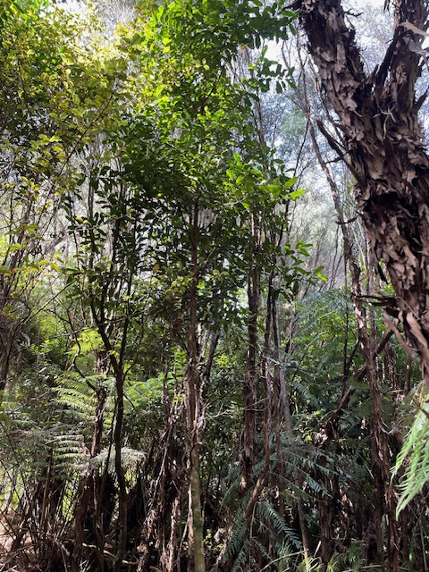
Section 2B (outside SNA)
kānuka/mānuka , ponga, native tree seedlings to 5m, pine trees

Slide 8
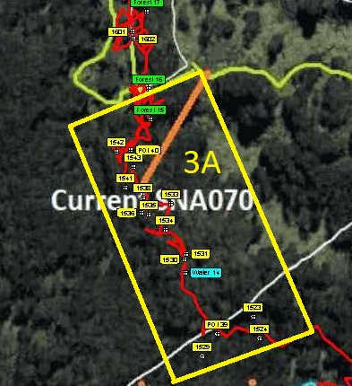
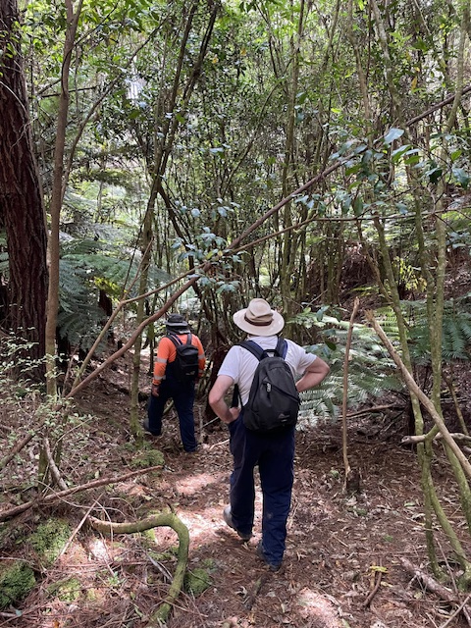
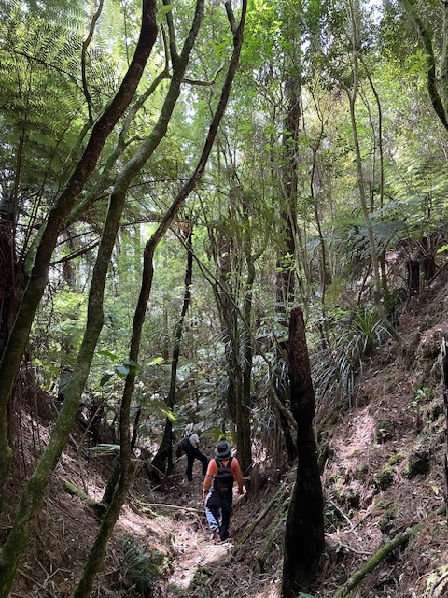
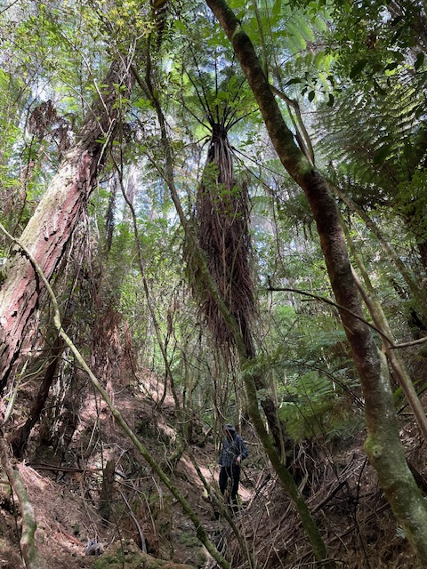
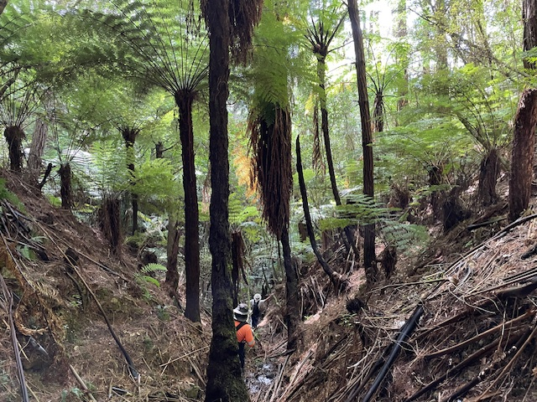
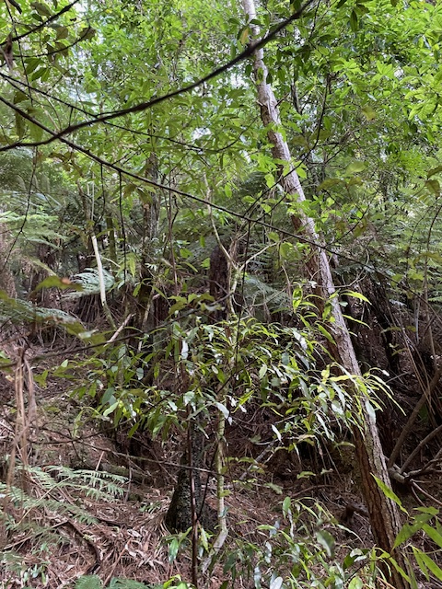
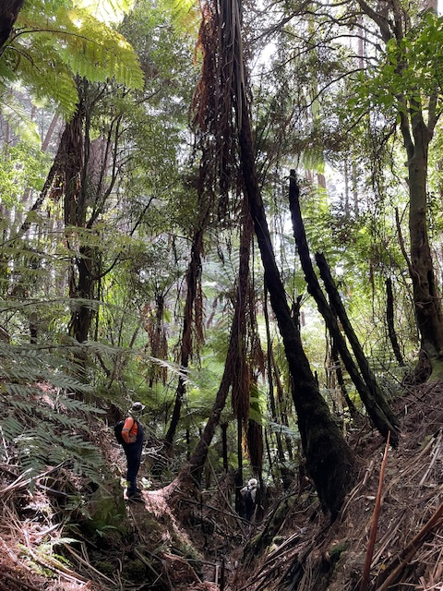
Section 3A (gully upstream of SNA, should also be SNA)
First water
mature mamaku, ponga, native tree seedlings
water started flowing here (not in SNA as stated in written submission)

Slide 9
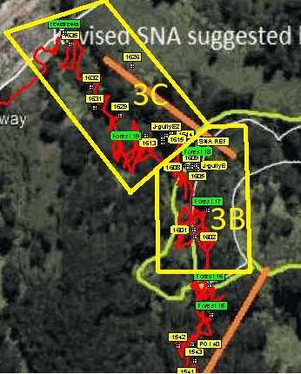
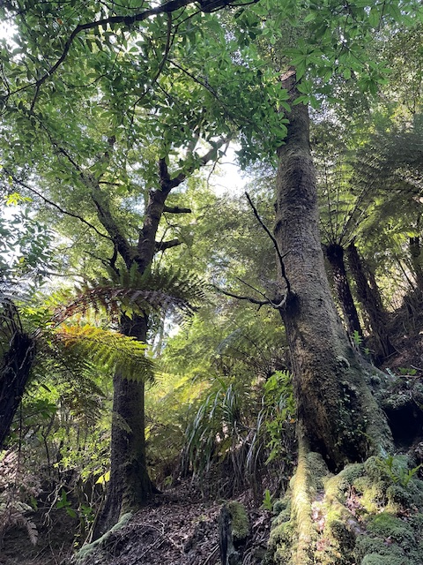
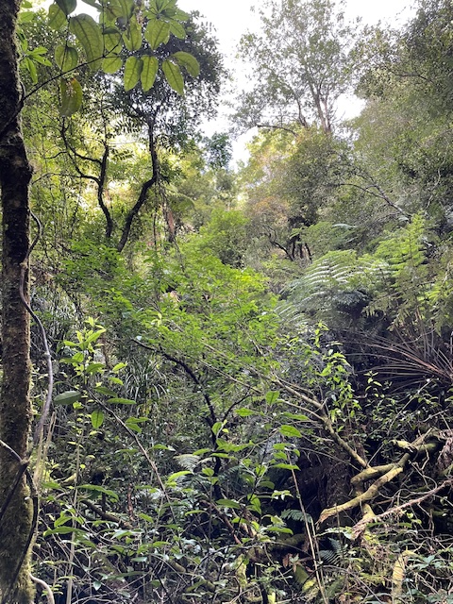
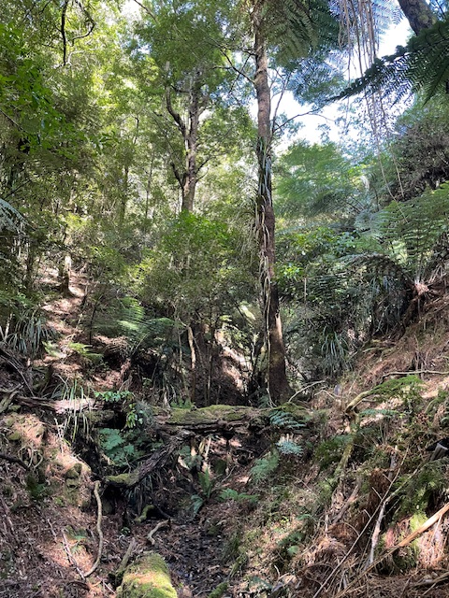
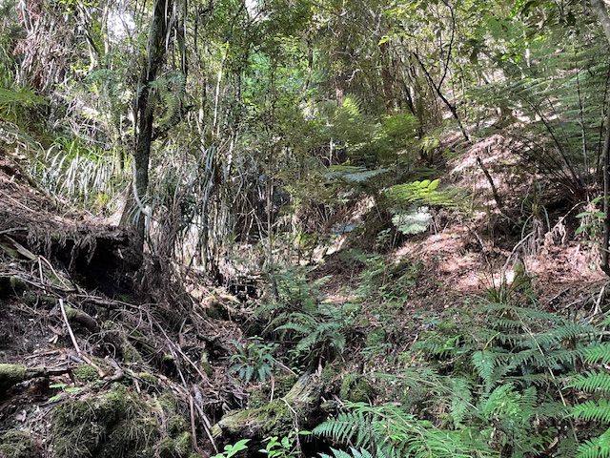
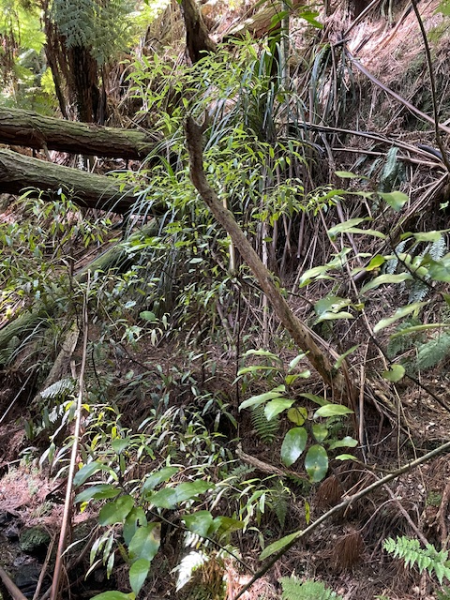
Section 3B (gully in current SNA as it should be, edge of VK revised SNA)
large beech on sides, mamaku, ponga,
native canopy tree seedlings
gully joining from east towards end of this section

Slide 10
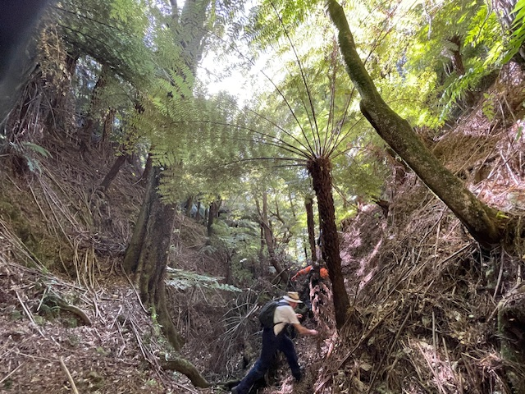
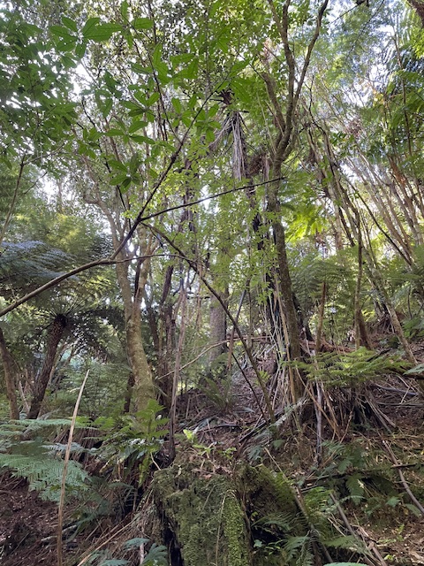
Section 3C (gully downstream of current SNA, should still be in SNA)
tall beech trees on banks,
mature mamaku, ponga, native tree seedlings
another gully joining from east near start of this section,
not weed infested

Slide 11
Section 4 (within current SNA, excluded by Dr Keesing)
miromiro and piwakawaka seen
kānuka/mānuka, ponga, mamaku, native tree seedlings
provides a link between more mature areas

Slide 12
Section 5 (within current SNA, excluded by Dr Keesing)
large beech, tōtara, kamahi, kānuka, mānuka, ponga, mamaku,
native tree seedlings of various heights,
pines north of SNA boundary

Slide 13
Vegetation Plots by Dr Keesing
Ambiguity in the locations of the vegetation plots in Dr Keesing’s statement of evidence 17/11/23 - not numbered in Fig 3 (reproduced above with waypoints added to calibrated map). No rationale given for selection of plot locations.
Discrepancy between locations of plots shown in Fig 1 of Mr Goldwater’s site notes from 22/12/23 visit (top right)
Discrepancy between descriptions of topography at plots in Dr Keesing’s statement of evidence and the topographic may from UHCC Xplorer (bottom right)

Slide 14
Conclusions
No reduction to the current SNA is warranted. Examples of advanced regeneration were found within sections that had extensive ponga and mamaku and are obviously being used by birds who are spreading seeds
The entirety of the section 1 gully should be added to the SNA to protect this permanent watercourse
The entirety of the section 3 gully should be added to the SNA to protect this permanent watercourse
Pine trees should be gradually killed rather than clear felled so as to not damage the native seedlings and reduce invasion by weeds

