Slide 1
Silverstream Spur
PC49 Variation 1 to the Operative District Plan
Simon Edmonds – Presentation Notes

Slide 2
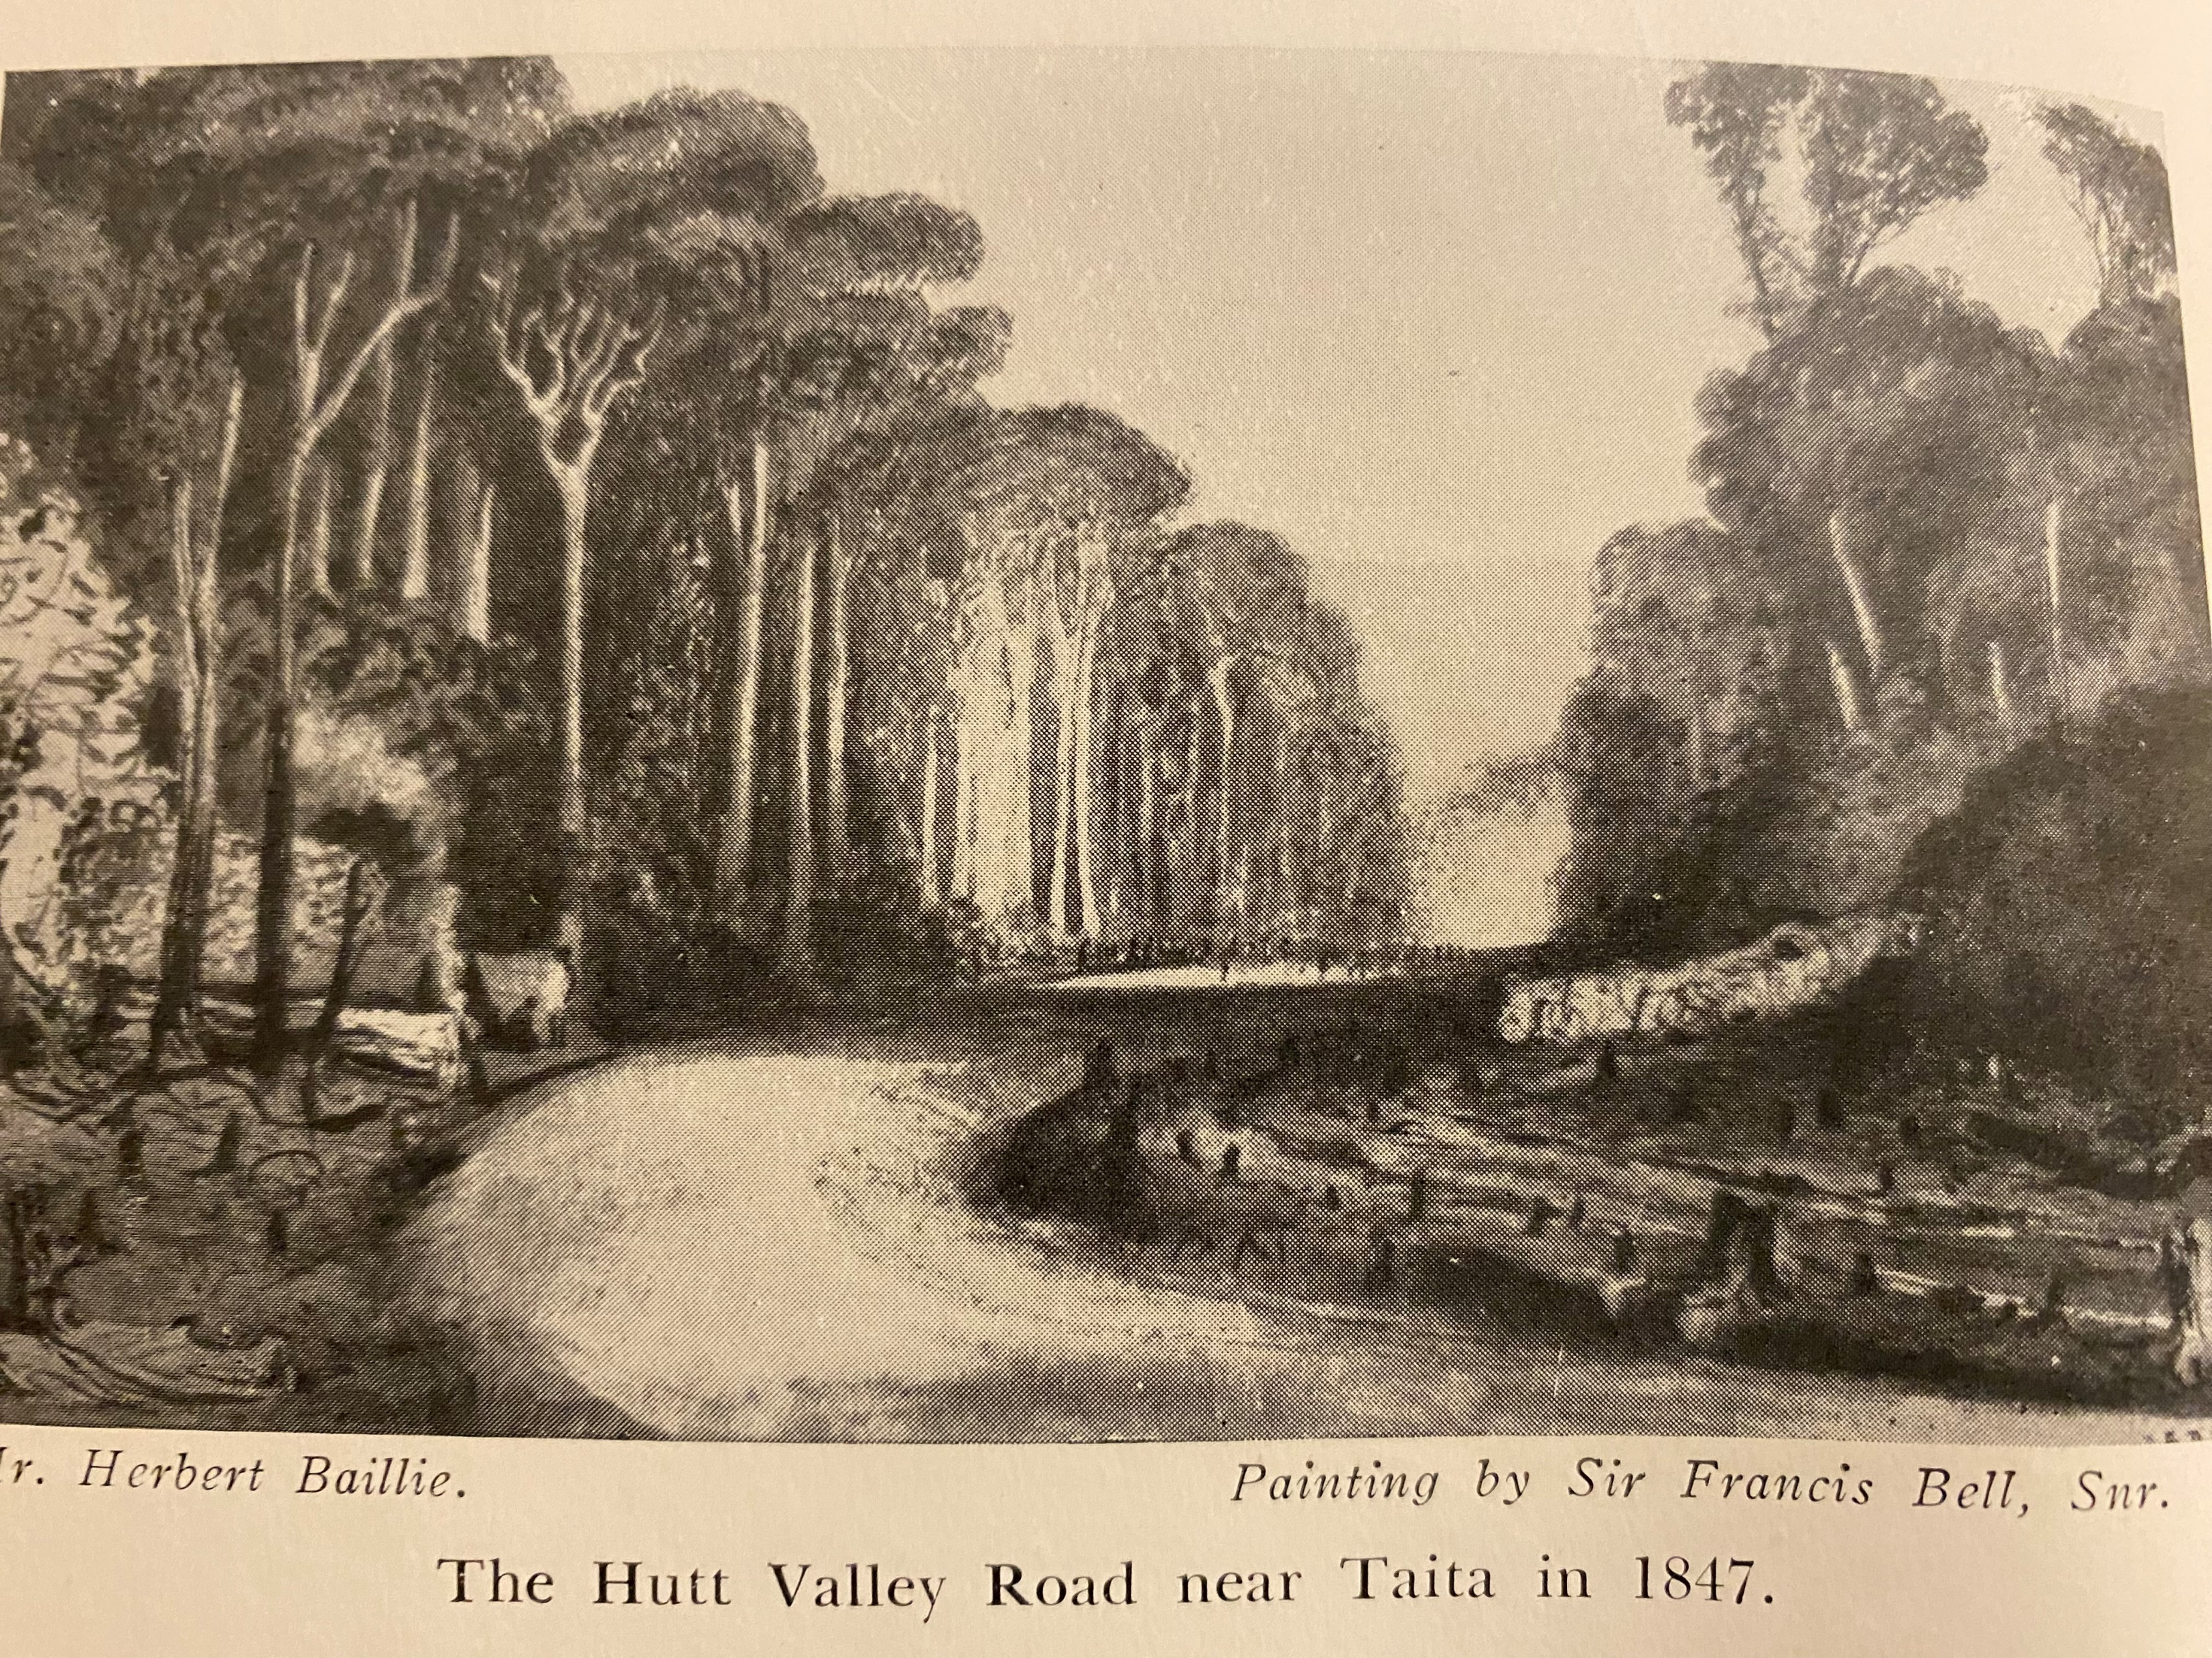

Slide 3
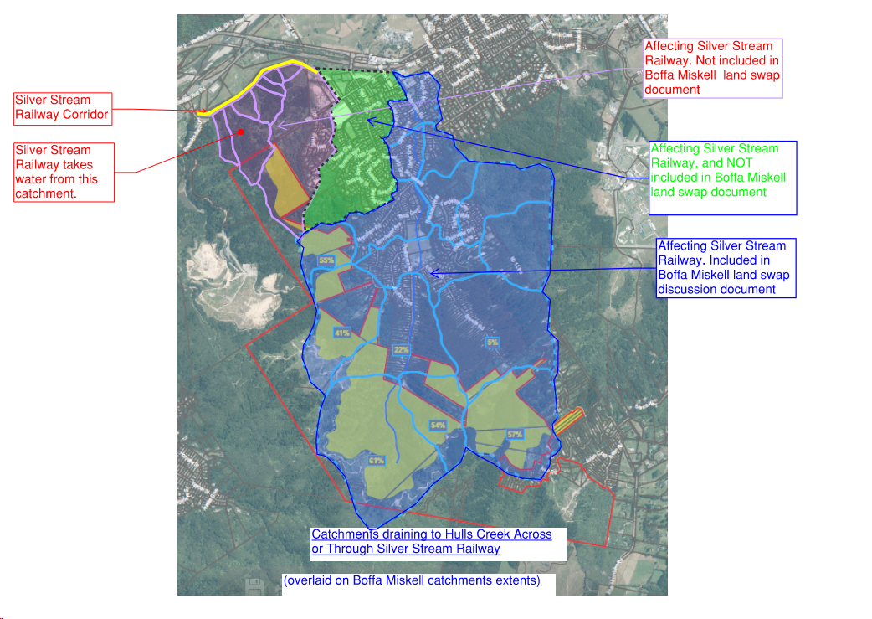

Slide 4
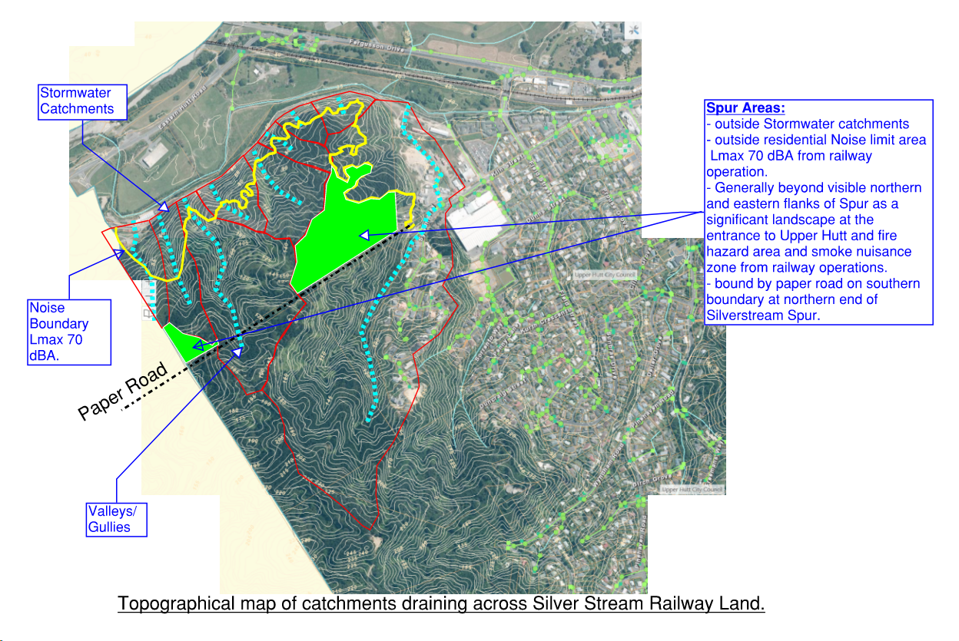

Slide 5
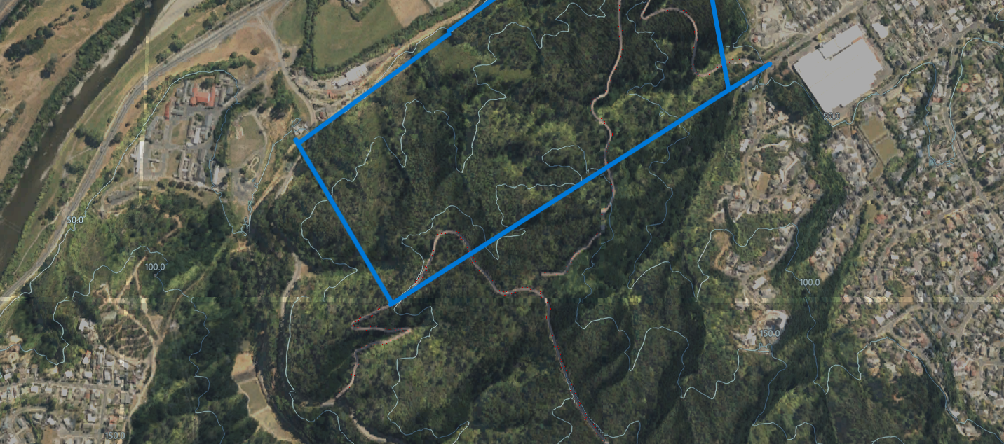
Plan of Spur and SGA showing conceptual road access options

Slide 6
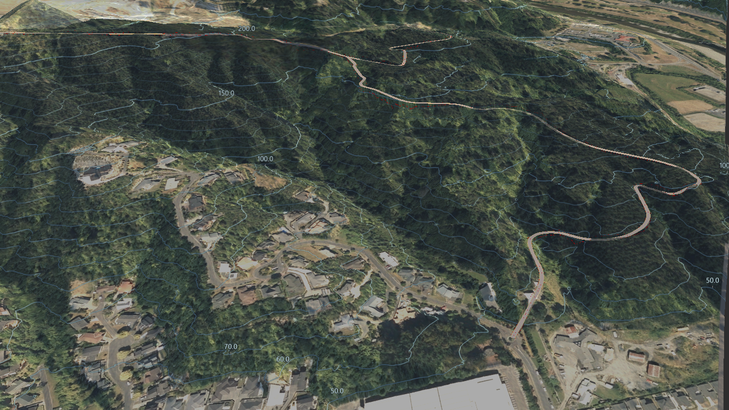
Conceptual Road Access from Kiln Street

Slide 7
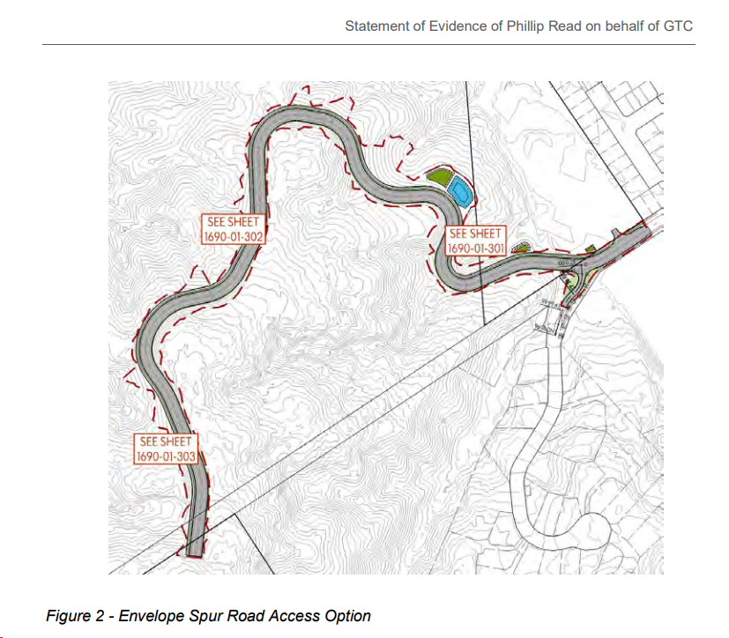
Conceptual Spur Road Access - Used for Infrastructure Accelerator Funding Application in 2022

Slide 8
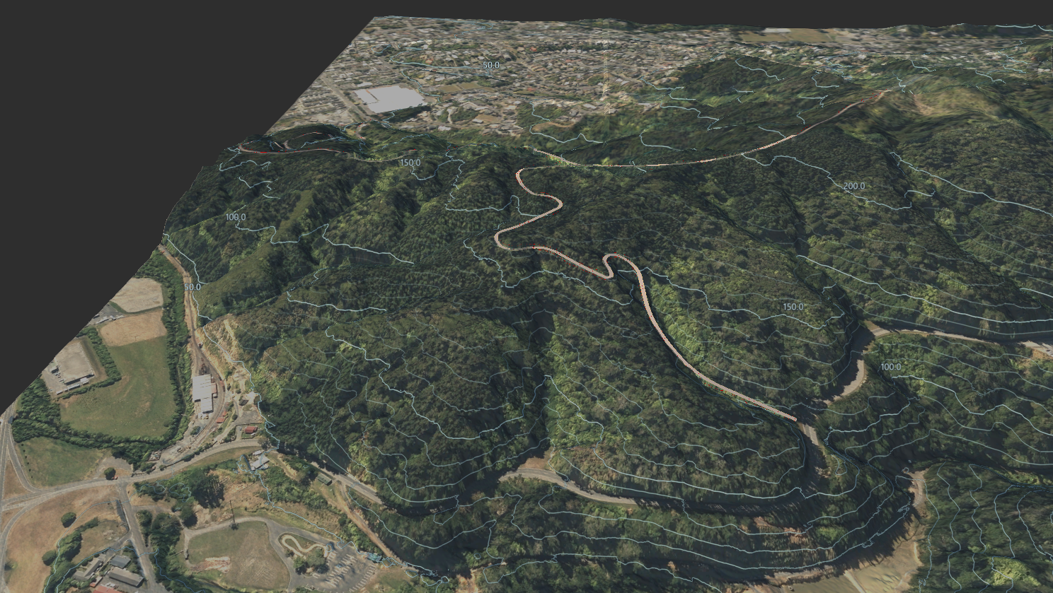
Conceptual Road Access from Reynolds Bach Drive

Slide 9
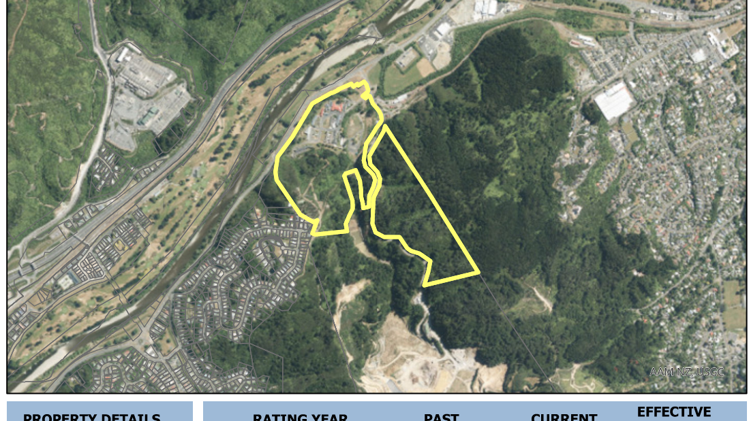
3 Reynolds Bach Drive Privately Owned Land

Slide 10
