Slide 1
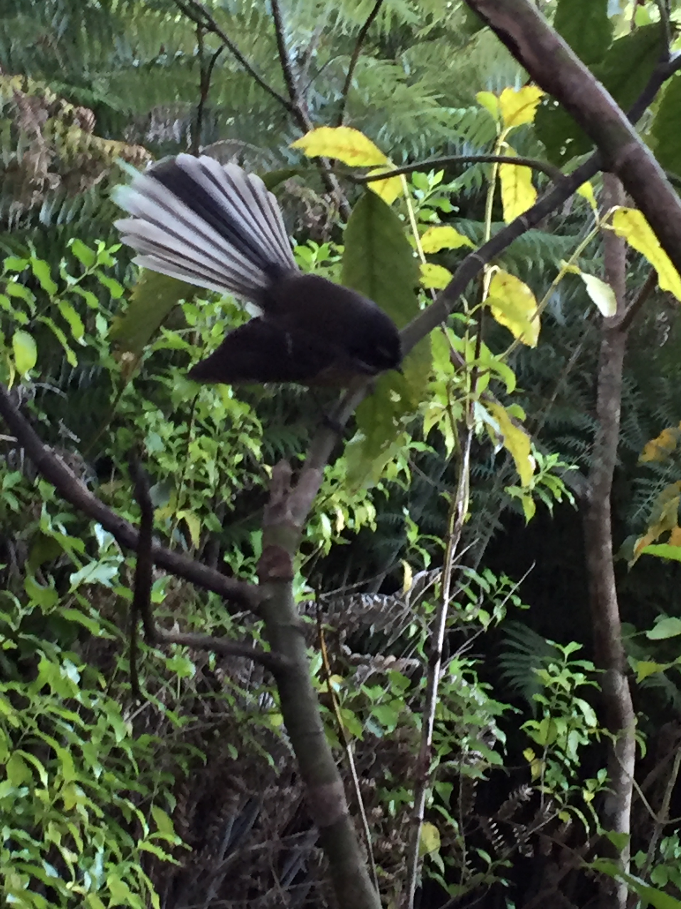
Dr Abbie Spiers
Environmental Scientist, Writer, Mediator, Local resident
Discuss the ecological values of the Silverstream Spur
Raise potential threats and relevant aspects of Reserve Planning Theory
Urge protection of the Spur as Natural Open Space, a future conservation reserve without infrastructure/transport corridor or housing.
PROTECT THE SPUR

Slide 3
The people of Upper Hutt bought the Spur because:
It is our ‘Green Gateway’ – the potential jewel in the crown of our Town Belt & Reserve system.
The Spur has:
Aesthetic and practical values now – to the public, some wildlife, and our much-loved heritage Silver Stream Railway.
Huge future potential as a reserve, with benefits for people, plants and wildlife.
PROTECT THE SPUR

Slide 4
Future native bush reserve
The Spur has excellent regenerative potential (it is already over 50% regenerating native bush)
A future native bush reserve
Potential for recreational walking tracks, public boardwalk viewing areas, and other low impact activities: Public education, wellbeing, and interest.

Slide 5
John Campbell, Forest Ecologist
Review of Boffa Miskell’s flawed report on the Ecological Values of Silverstream Spur
PROTECT THE SPUR

Slide 6
John Campbell’s key points:
The Spur must be viewed in its broader regional context
The forest types assessed by Boffa Miskell were entirely wrong
The Spur has excellent prospects for regenerating native forest – and is already doing it!
South of Kaitoke, Silverstream Spur is Upper Hutt’s only remaining corridor link with the western side of the Valley
Short-term considerations should not override the future benefits of retaining a healthy environment & diversity of species.
PROTECT THE SPUR

Slide 7
Why worry?
If there is ‘just a road’ going up on the Spur now, why are we worried about it?
It’s not just a road!
It’s an Infrastructure Corridor.
Infrastructure Corridor = a Road + Power, Telecommunications, Three Waters, etc.
PROTECT THE SPUR

Slide 8
Why worry?
Roads are problematic in reserves.
Road corridors are a conduit for pests, weeds & other impacts.
Roads are also a barrier for species to cross.
PROTECT THE SPUR

Slide 9
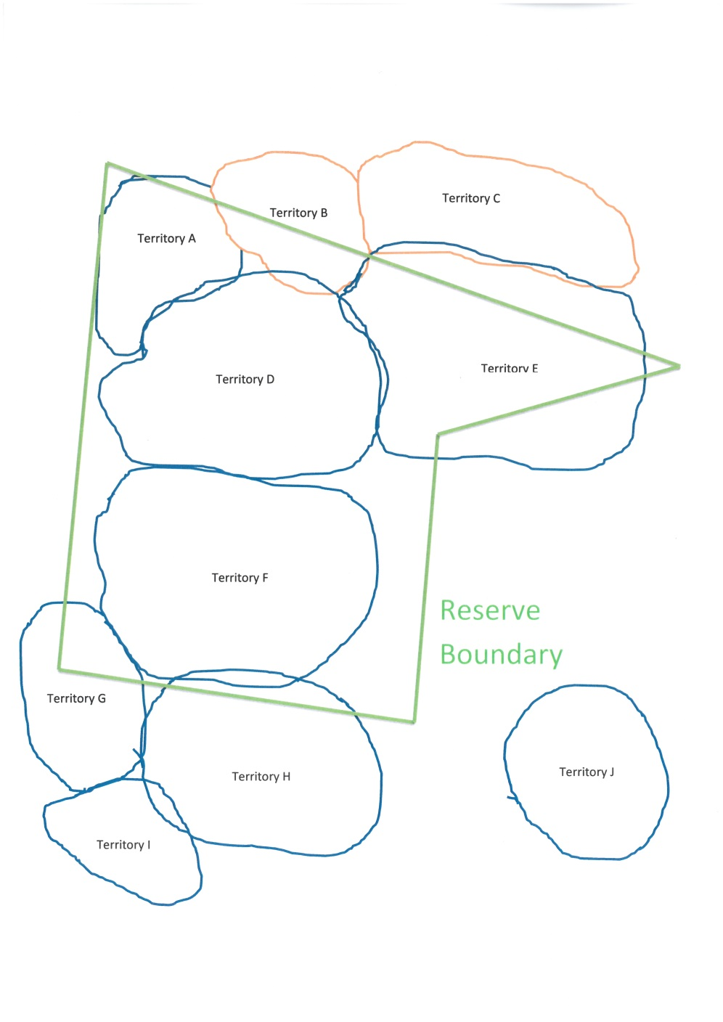
Reserve Planning Theory
Size matters:
Reserves should be big enough to support viable populations of vulnerable native species, and/or food sources for them.
The Spur is an excellent size, almost 50 hectares.

Slide 10
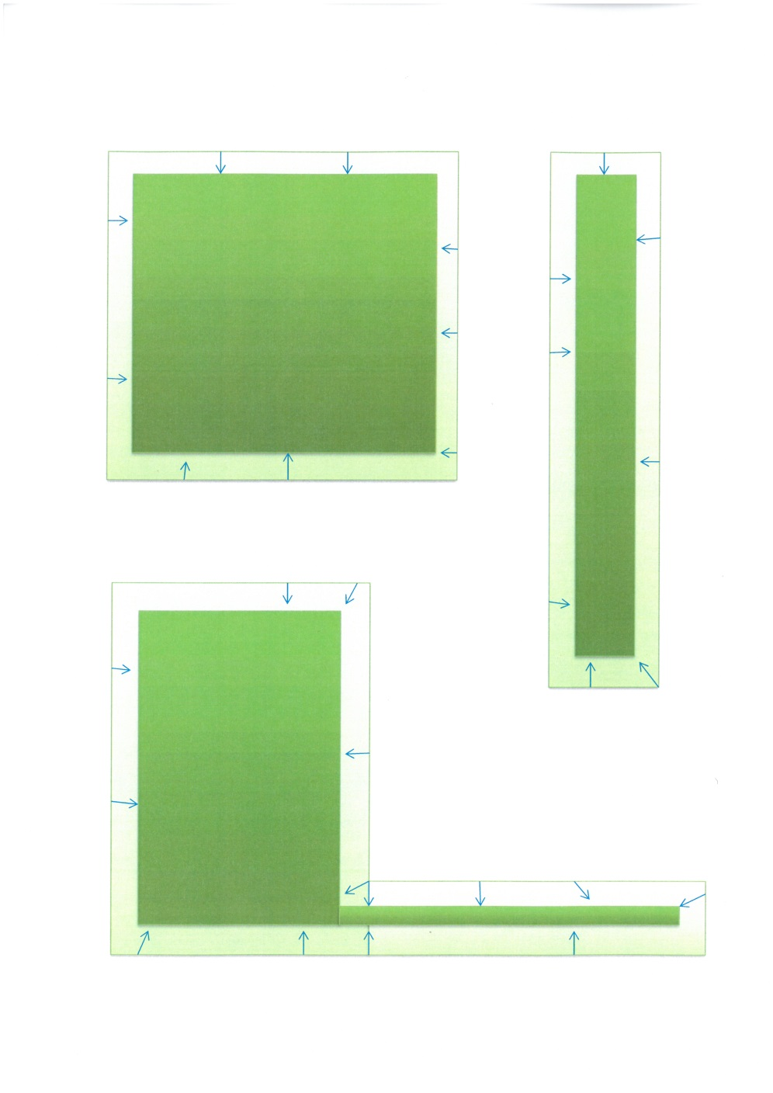
Shape matters:
Edge effects are caused by weeds, pest species, fire risk and other threats encroaching on reserve boundaries.
Narrow strips of land will likely be of lower conservation value than wide ones in the long term.
In our example, the “square” reserve has lost 28% of its habitat to edge effect – the narrow reserve has lost 52% - and the “L” shaped reserve is 58% impacted due to the very narrow strip.

Slide 11
The closer a reserve’s shape is to square or circular, the more likely it can protect high value habitat in the middle.
The Silverstream Spur is an excellent shape to protect the high value SNA’s within it.

Slide 12
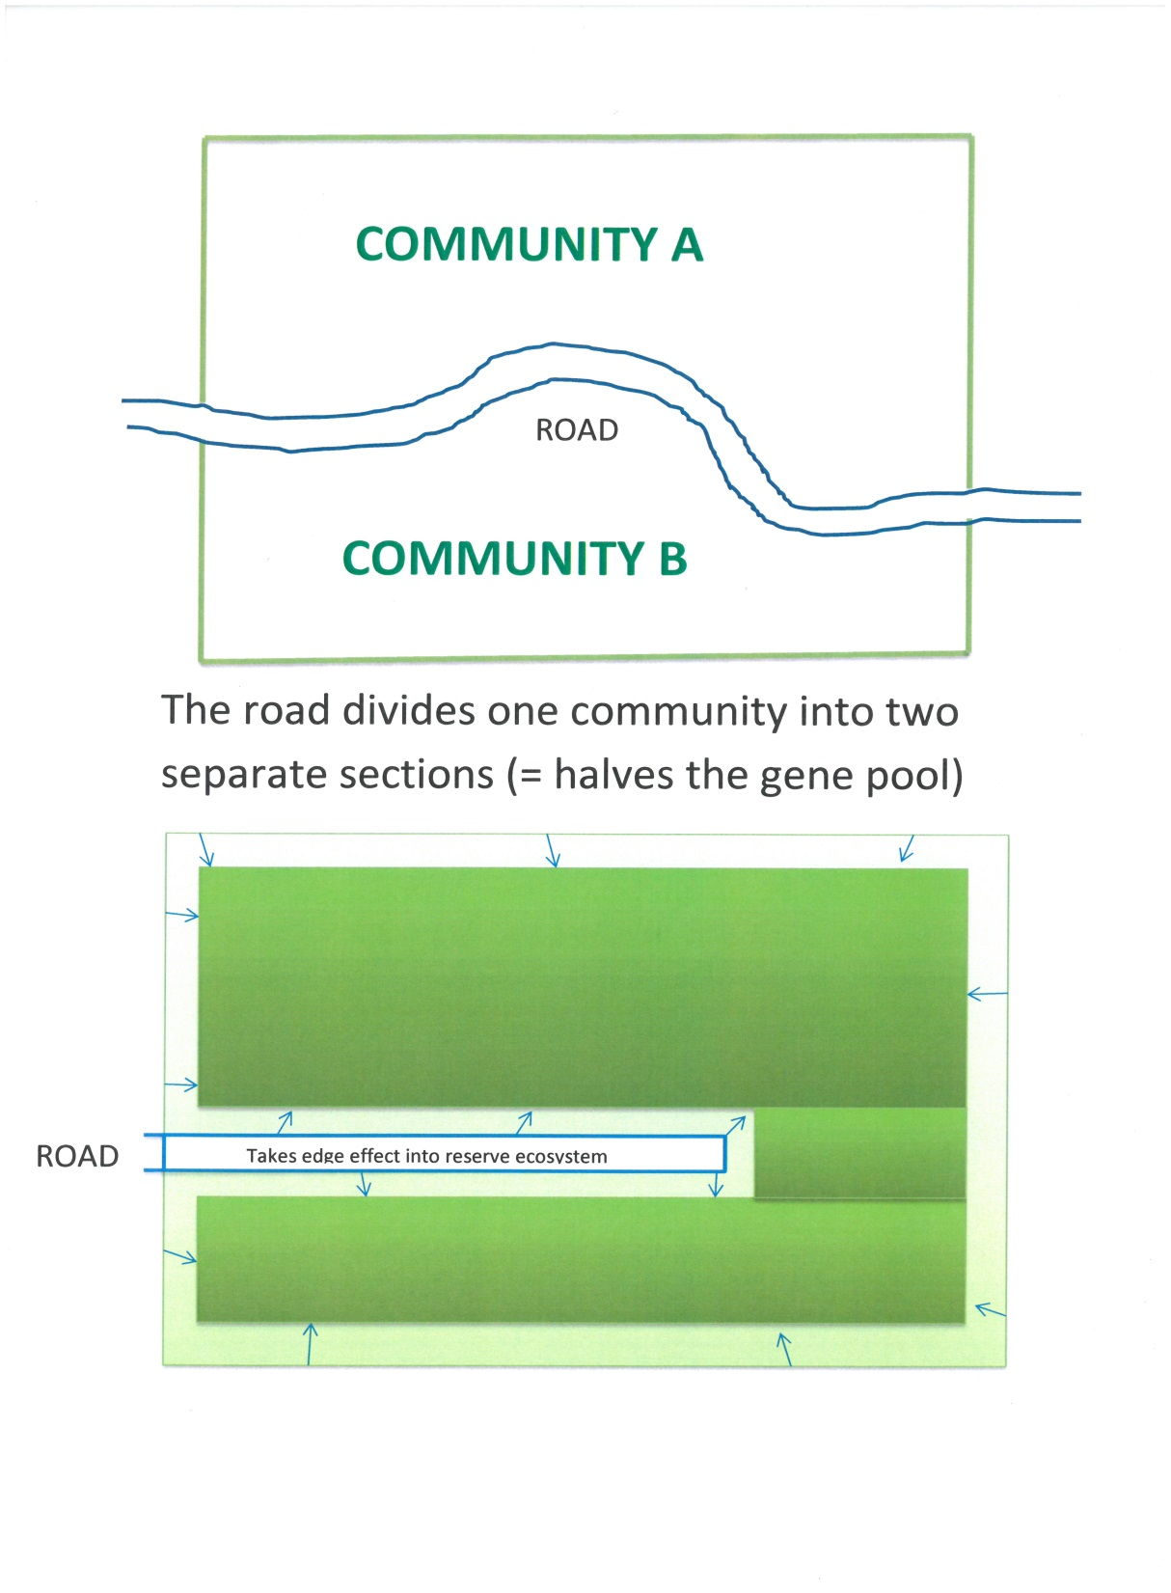
Reserve Planning
Roads:
Roads act as ‘barriers’ & conduits for destruction in reserves
Roads are too wide for some species to cross safely
They bring edge effects along their length

Slide 13
Roads have no place in reserves if we can possibly help it!
They are especially damaging if they go through the middle.
PROTECT THE SPUR

Slide 14
Due to the Spur’s topography, it is highly likely the road or infrastructure corridor would have to go through the middle.
Possibly even through SNA habitat.
There is no imperative for a road through the Spur – as a community, we have alternatives!

Slide 15
Aren’t the existing roads, rivers and railways in the Hutt Valley ecological barriers, too?
Yes. We don’t need another one.
This road is wide, long, and in the wrong place.
It is unnecessary. It will bring fill and stormwater impacts, weeds, pests, and an additional barrier to ecological regeneration.
PROTECT THE SPUR

Slide 16
In summary, I urge UHCC to…
Protect the Silverstream Spur as natural open space and a native bush reserve for the future.
Protect SNA's on the Spur from ALL forms of development including infrastructure for development, transport corridors and roads
Roads become corridors for pests, weeds, erosion, habitat loss and other disturbance of the native species we want to protect in the first place.
Incompatible with protection of our valuable SNA’s.

Slide 17
UH public deserve an aesthetic and ecological Green Gateway to Upper Hutt!
My submission:
“I urge UHCC to support the rezoning of the Spur, support the protection of the Spur SNA's from ALL forms of development, infrastructure or roading, and reject the proposed site-specific provisions – thereby protecting the Spur (and SNA's) in its entirety as Natural Open Space with no caveats.”

Slide 18
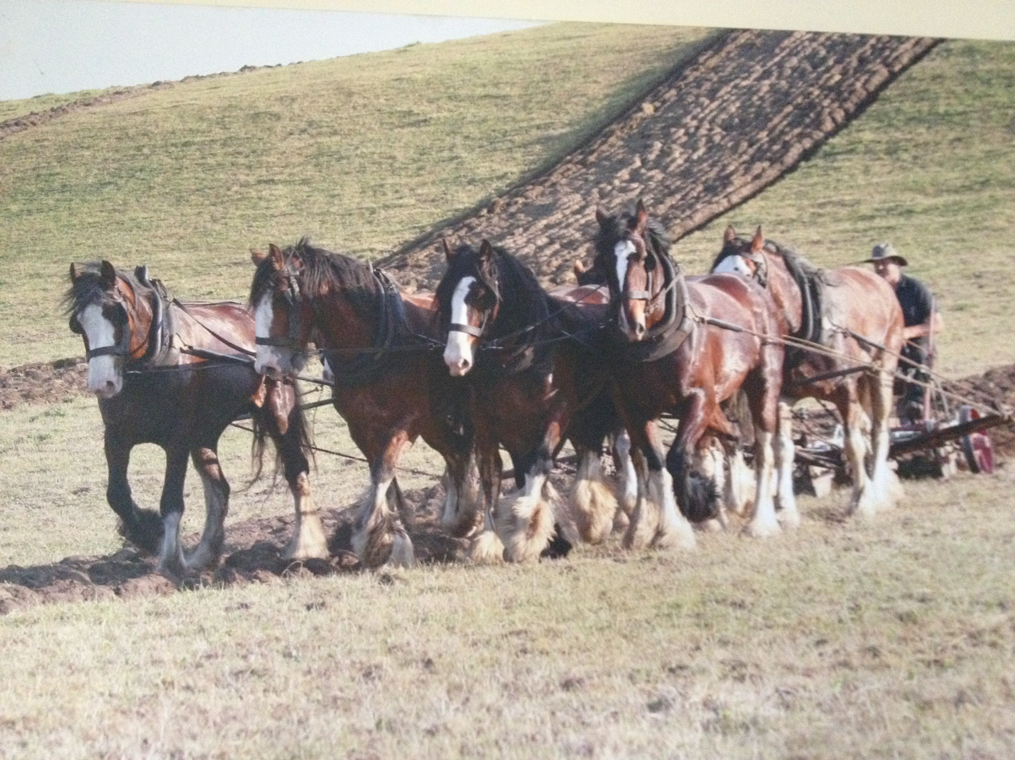
I believe, just like these Clydesdales work every day as a team, we can work together to protect and restore the Spur!
Dr Abbie Spiers
Ph 027 6150352
ramblers.song@gmail.com

